Slide 1
Milestones Achieved (Month 2)
M_3_2: (A) Accident Detection
Model Specifications: We used YOLOv8-Medium architecture consisting of 295 layers and 25,902,640 parameters.
Hyperparameters: The hyperparameters for the trained model are listed below.
Image Size | 640 x 640
Batch Size | 8
Optimizer | Adam
Callbacks | Patience = 25
Epochs | 250
Dropout | 0.3
Train : Validation : Test | 0.625 : 0.25 : 0.125

Slide 2
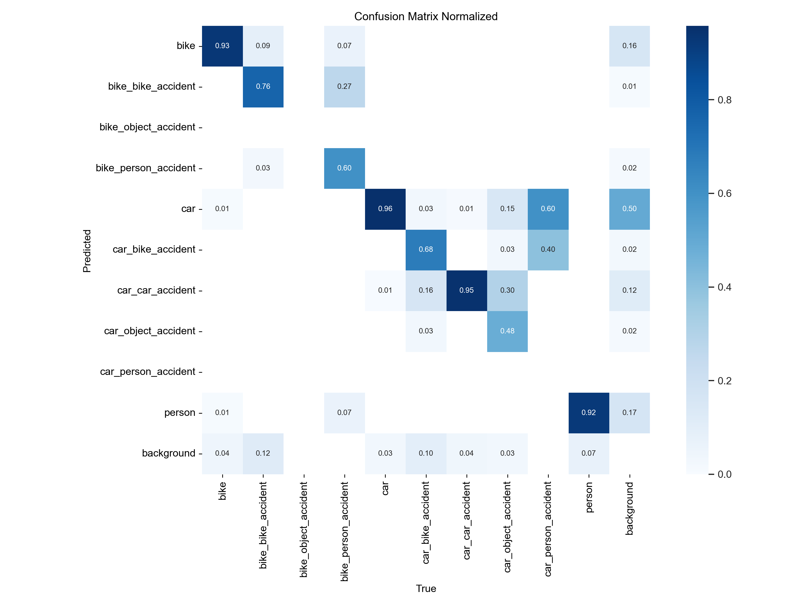
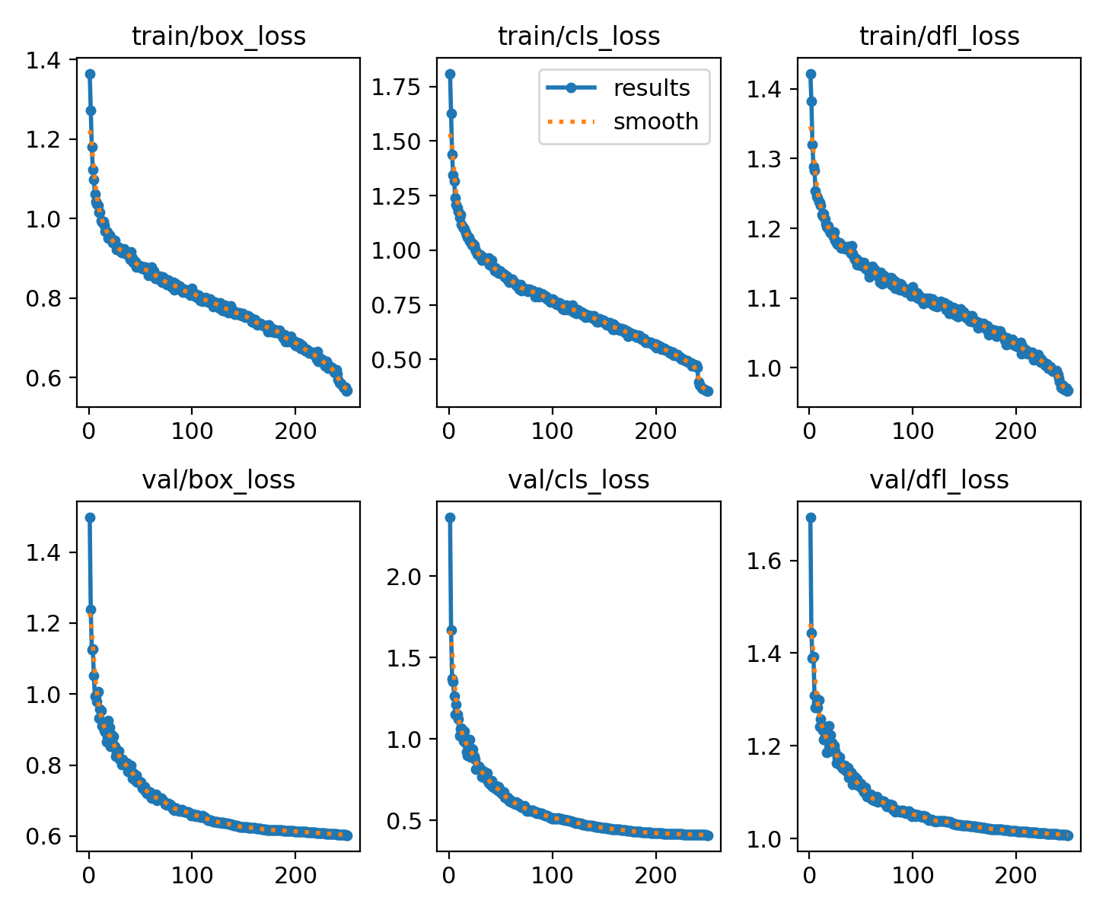
Milestones Achieved (Month 2)
M_3_2: (A) Accident Detection
Quantitative Results

Slide 3
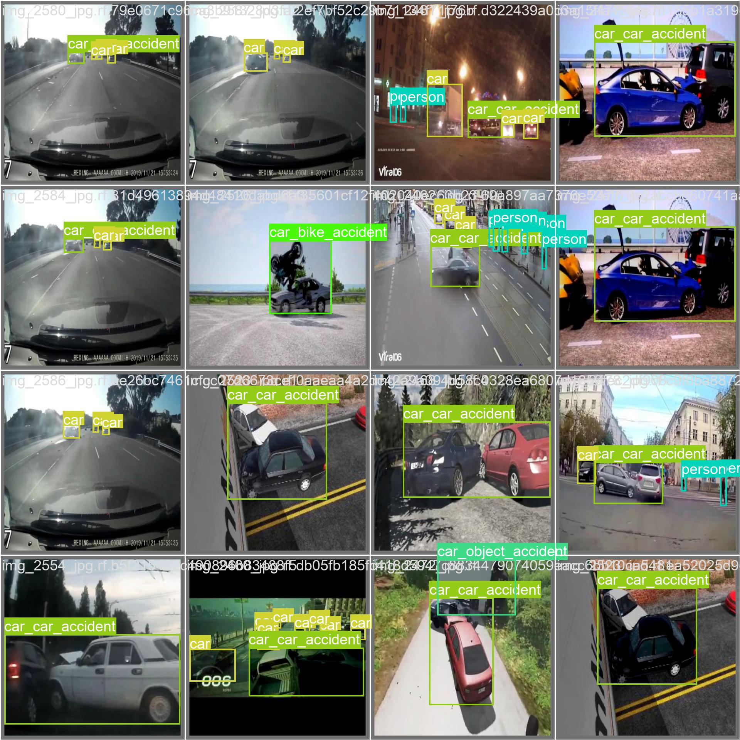
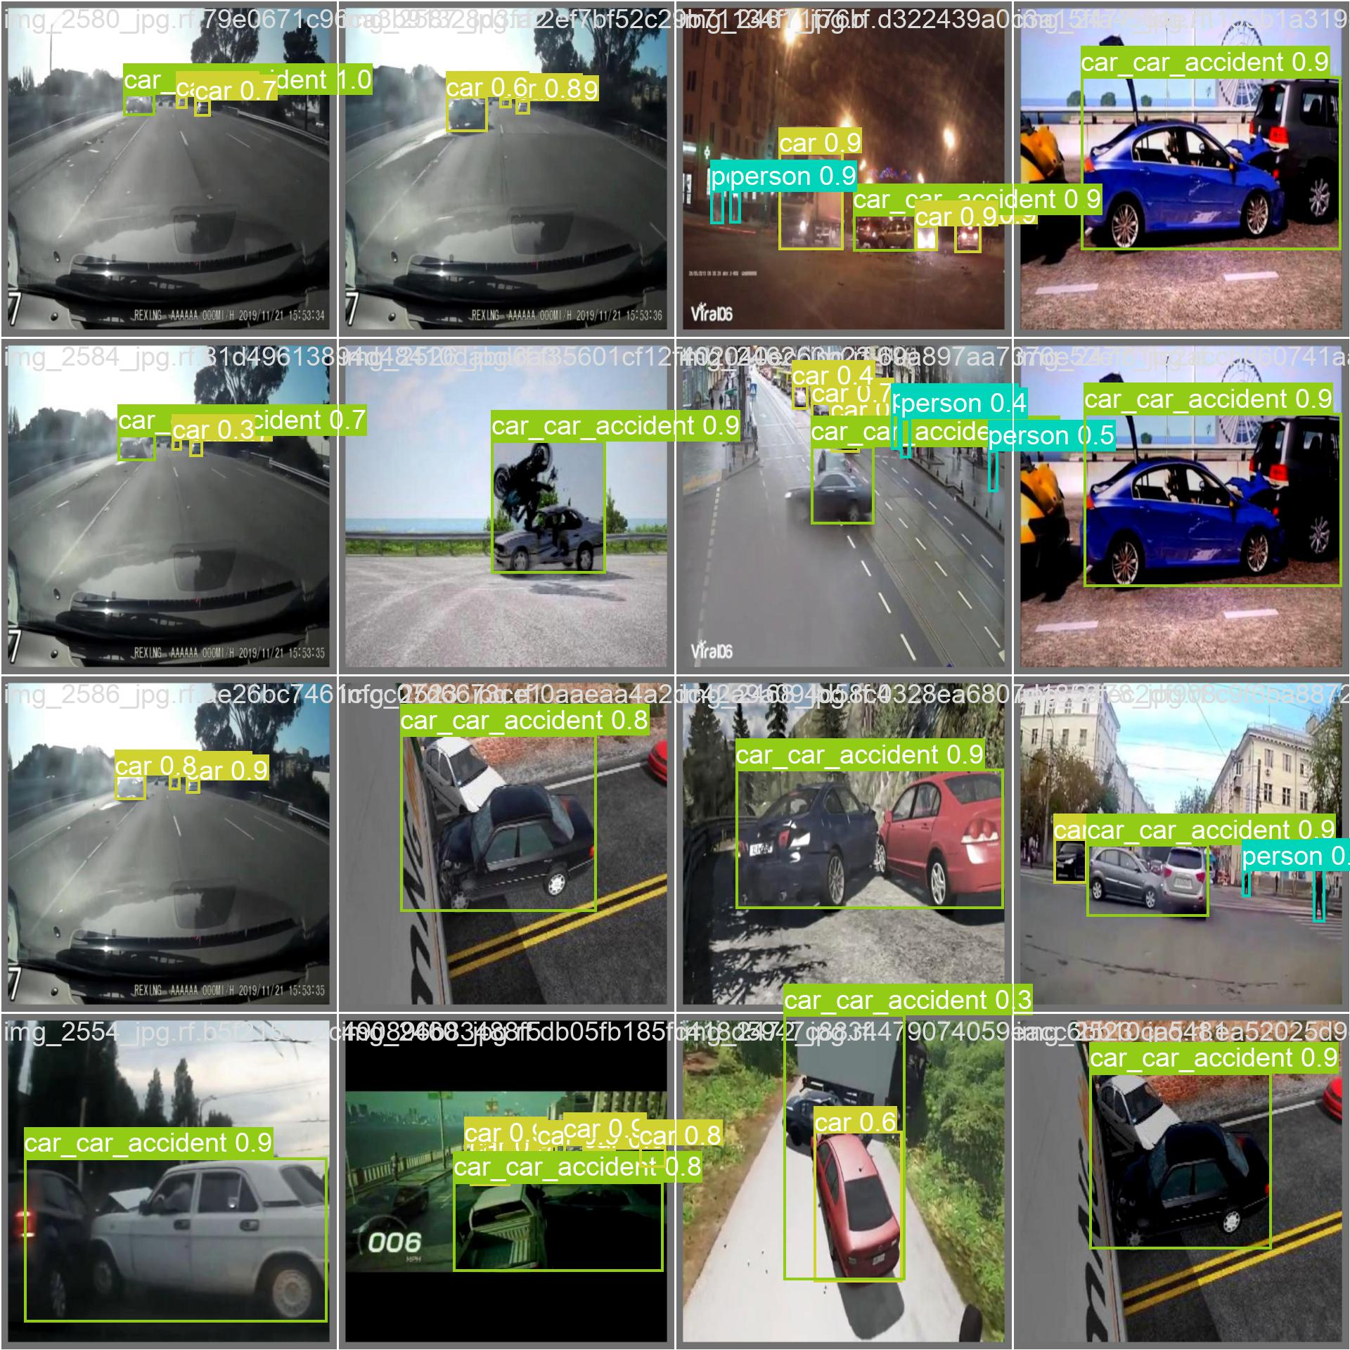
Milestones Achieved (Month 2)
M_3_2: (A) Accident Detection
Qualitative Results
Labels
Predictions

Slide 4
Milestones Achieved (Month 2)
M_3_2: (A) Accident Detection
Prediction results on a CCTV video

